Slide 1
IT’S GETTING HOT IN HERE!
World Climate Data 1750-2013

Slide 2
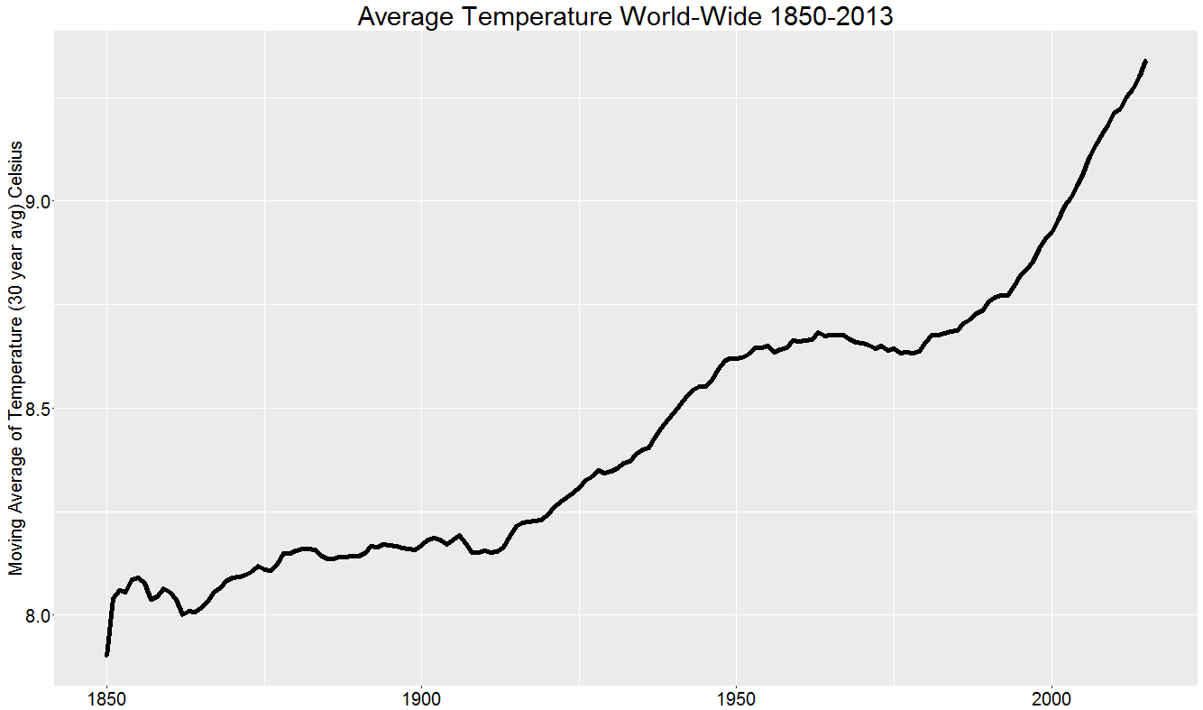
Climate Data Trending Upwards

Slide 3
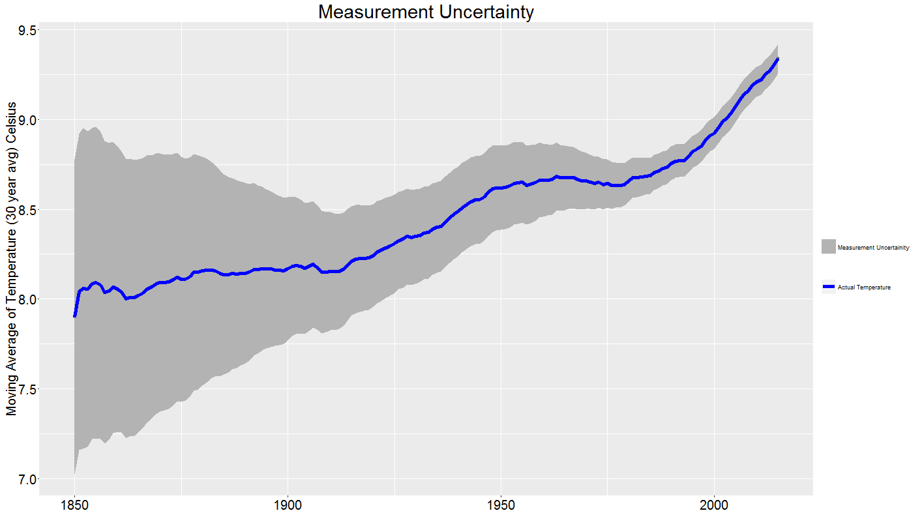
Temperature measurement of Upper and Lower Uncertainty

Slide 4
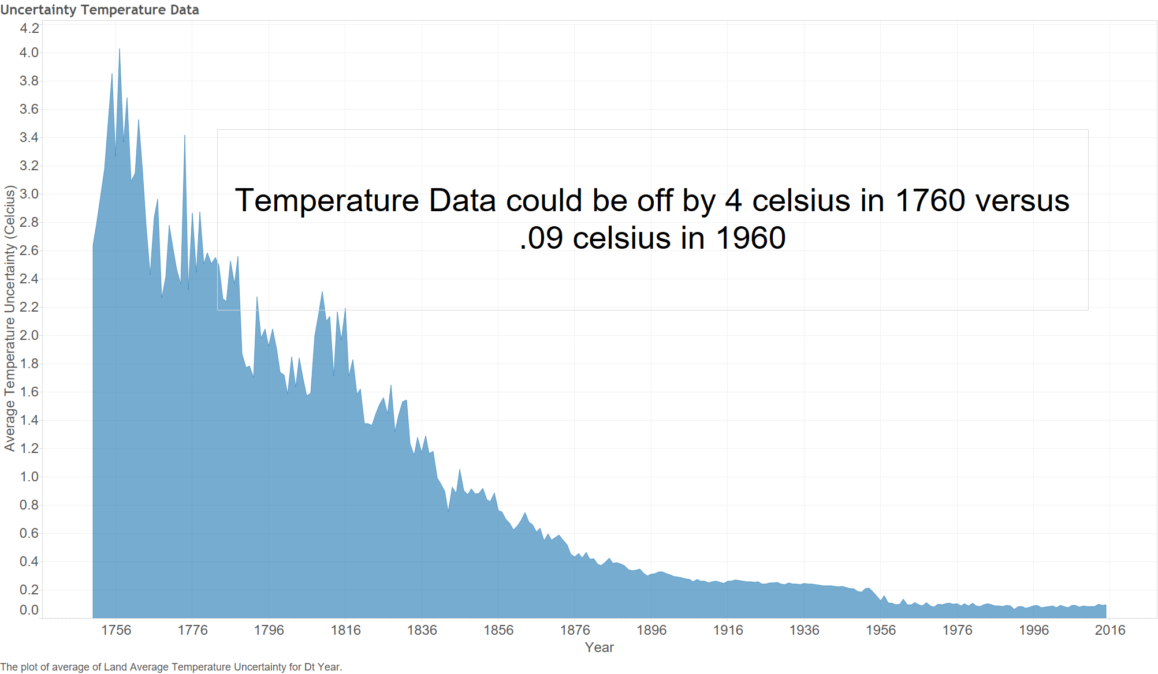
Why we want to focus on after 1960’s

Slide 5
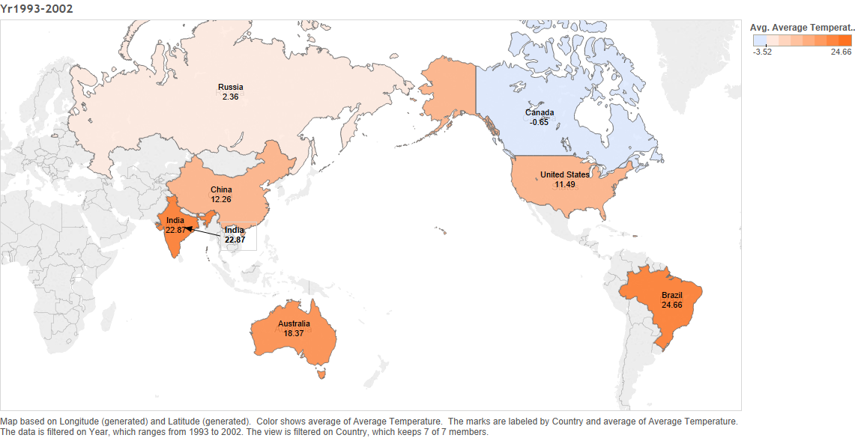
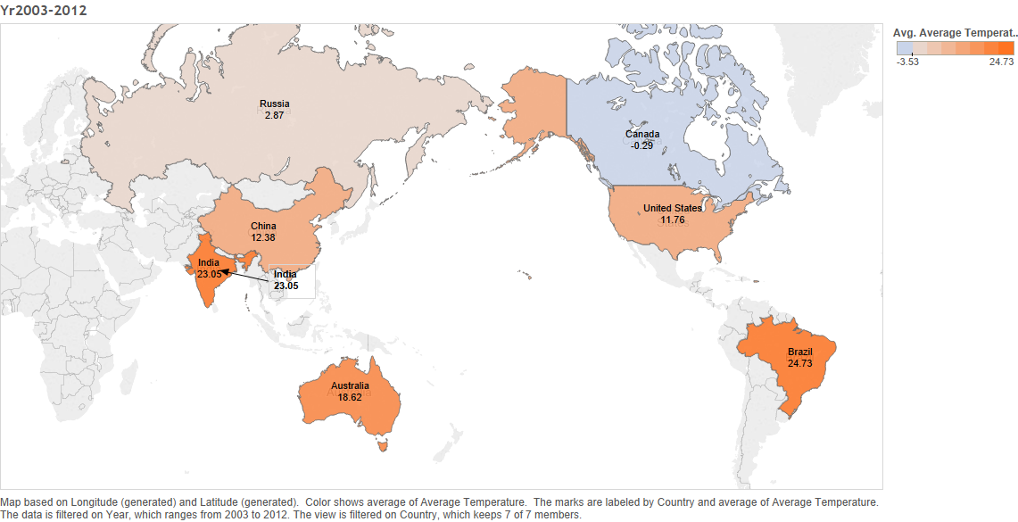
Which country has change in Average Temp since 1993?
Russia 0.51 Celsius ,Canada 0.36Celsius, U.S.A 0.27 Celsius

Slide 6
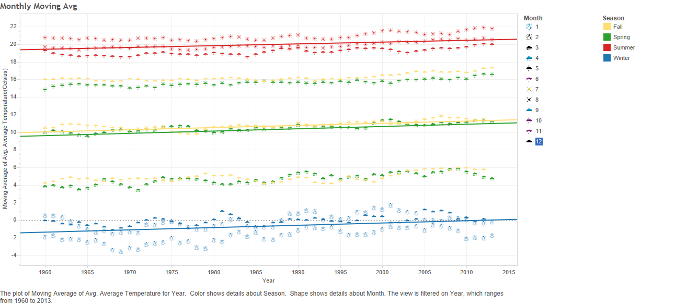
Is seasonal/month Avg Temp is increasing?

Slide 7
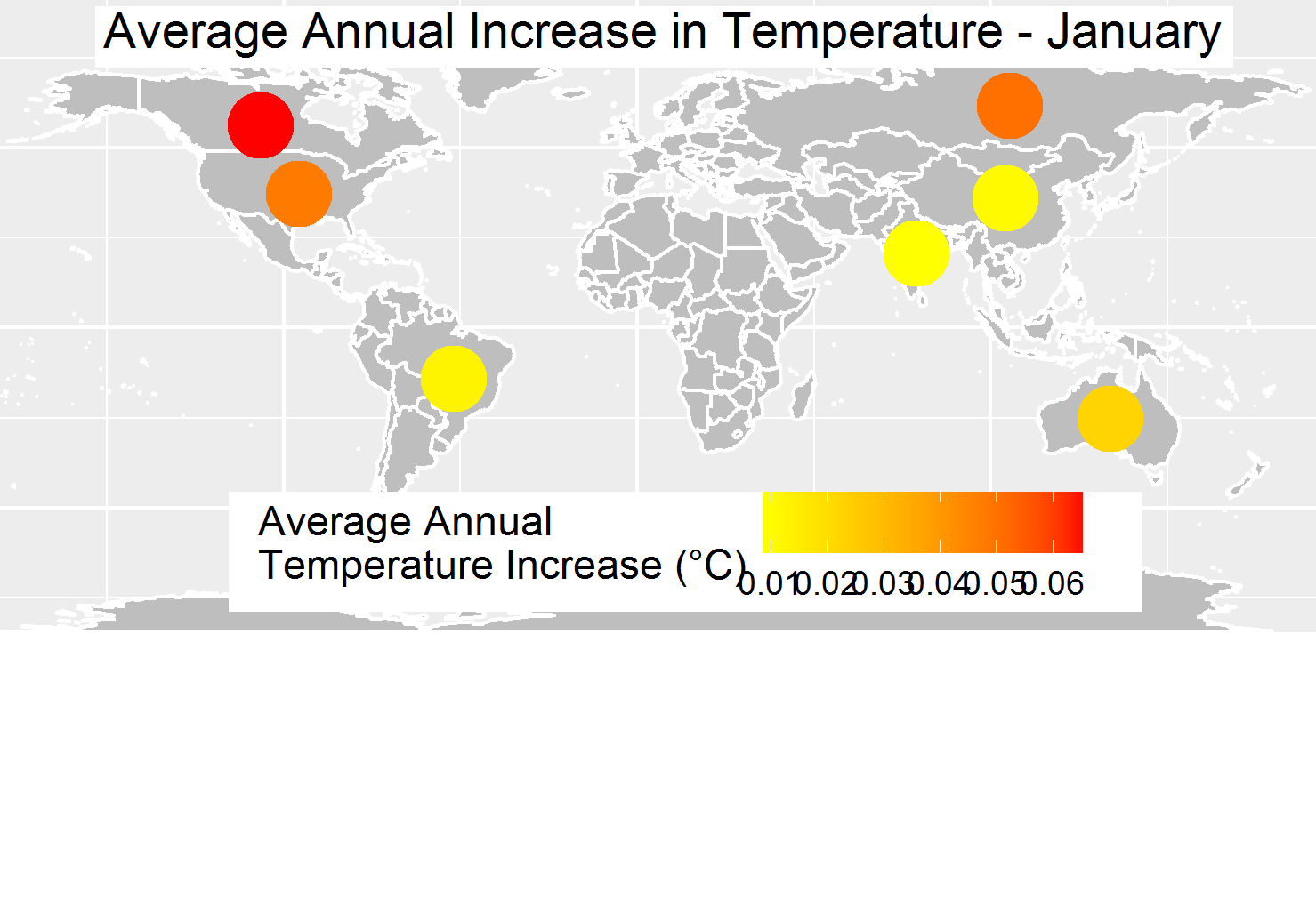
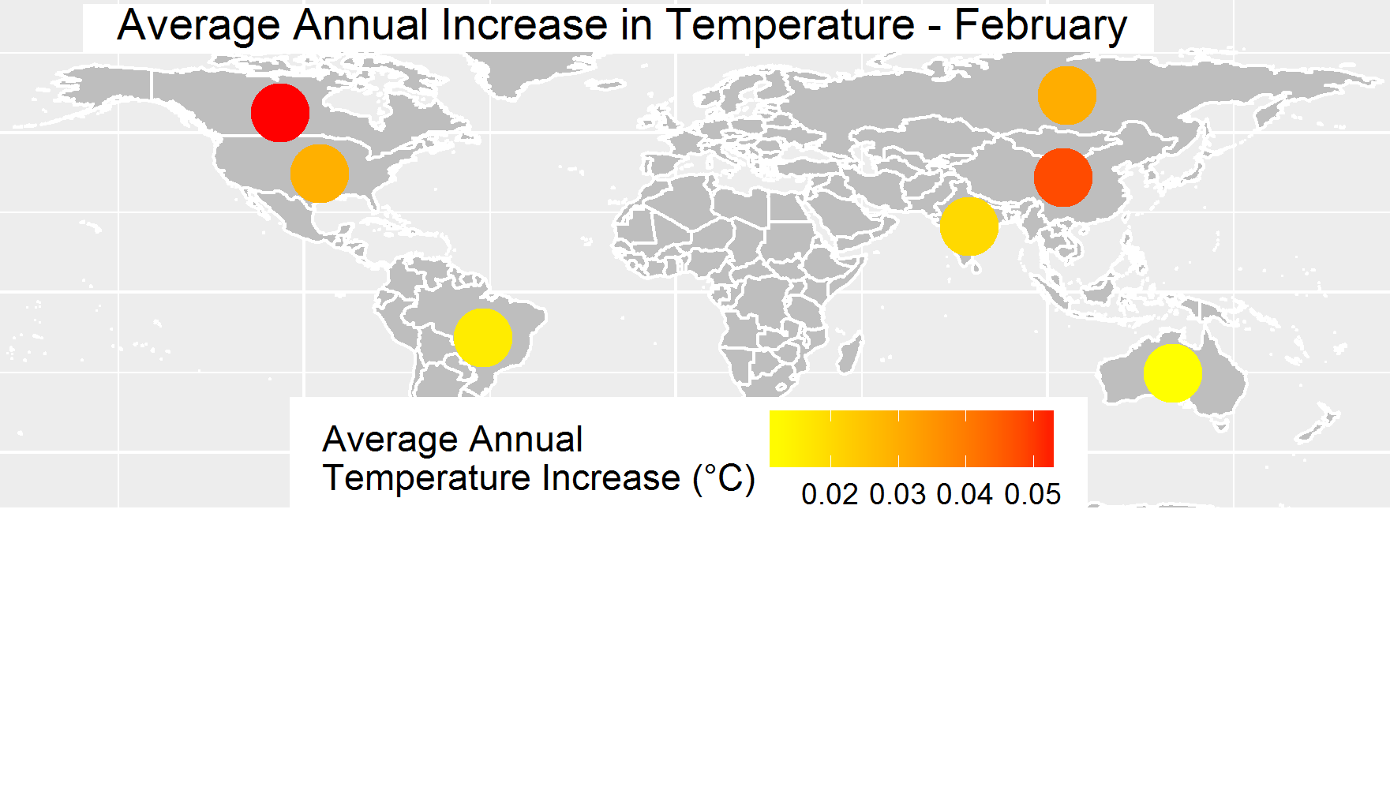
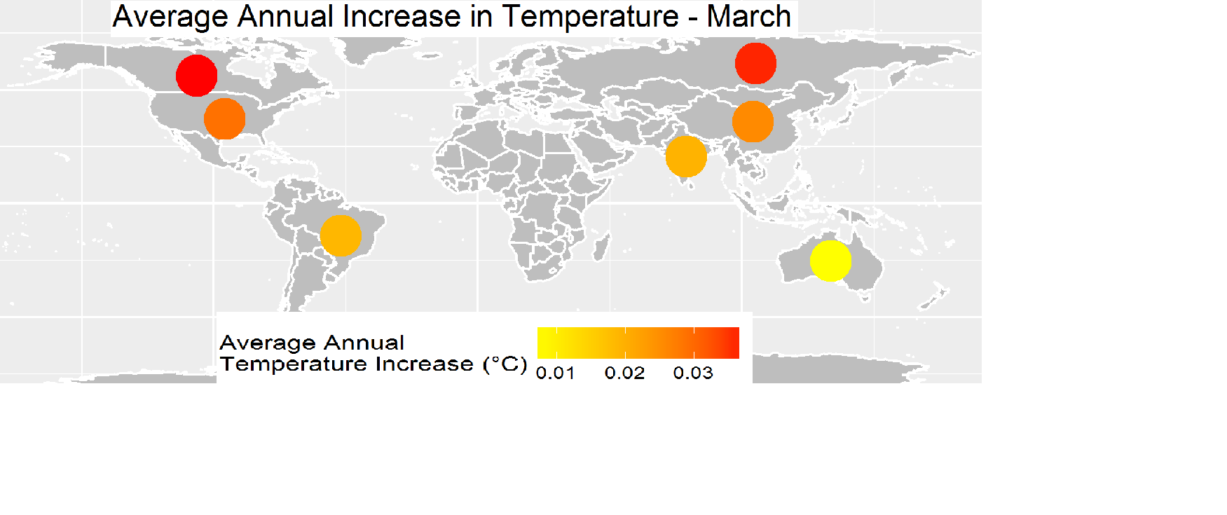
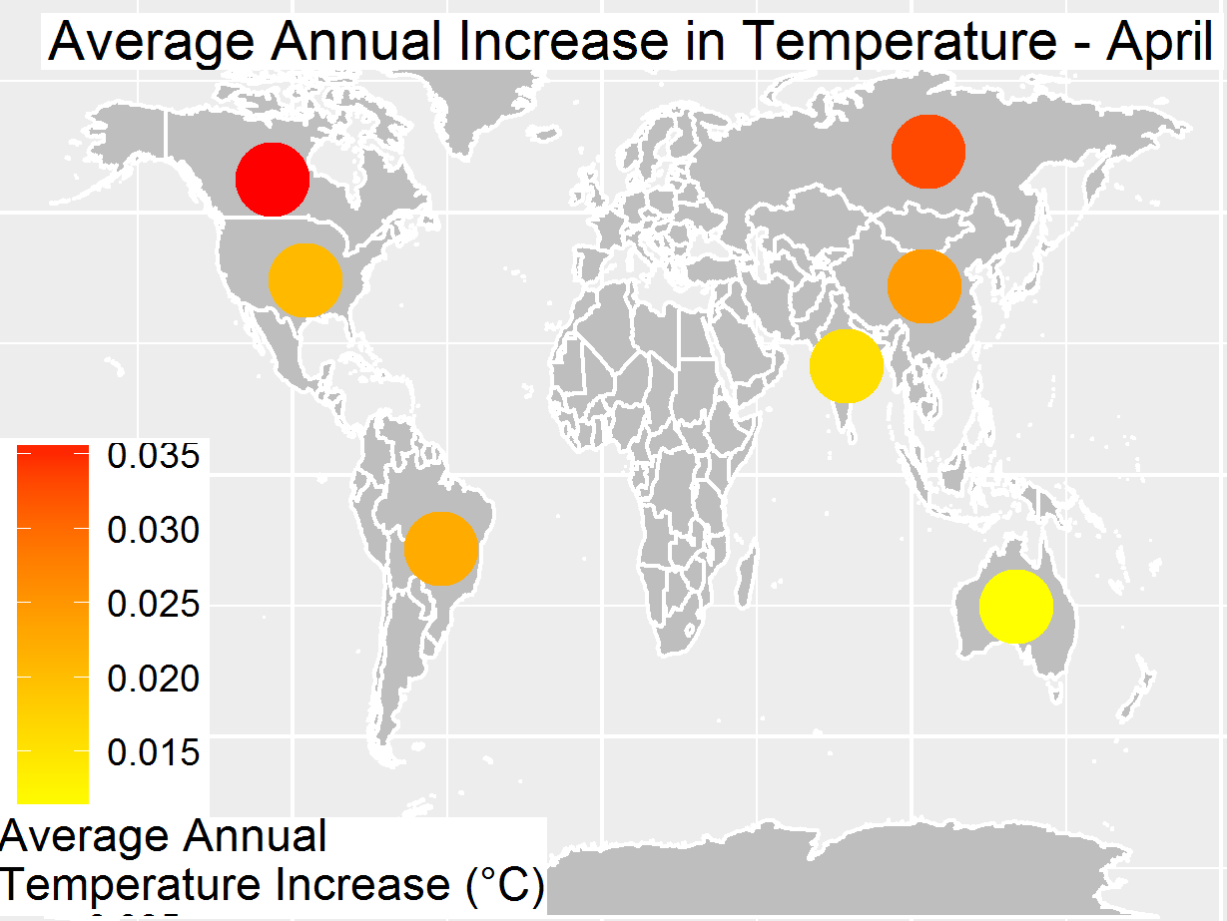
Monthly Avg Temp increase Jan,Feb,Mar,Apr since 1960

Slide 8
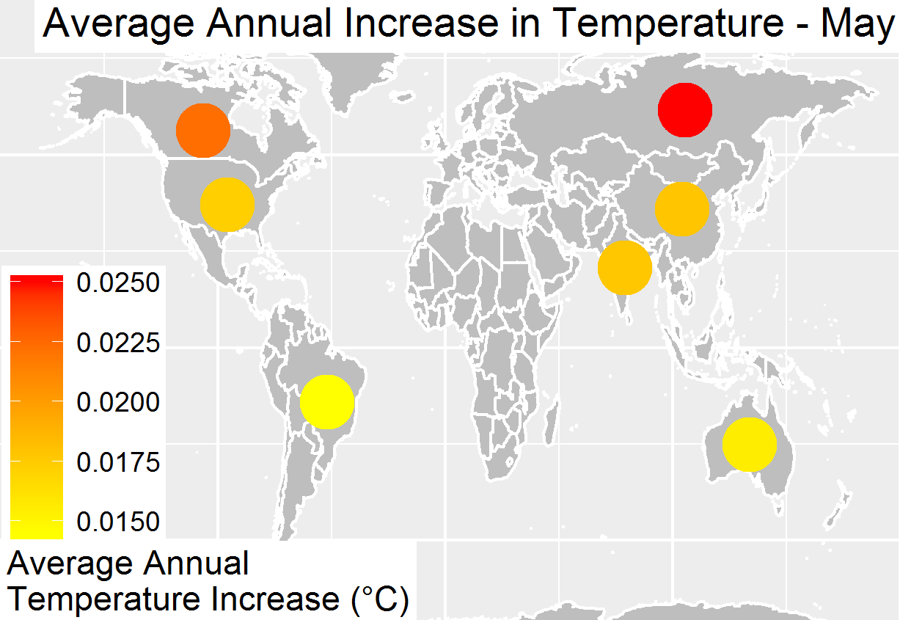
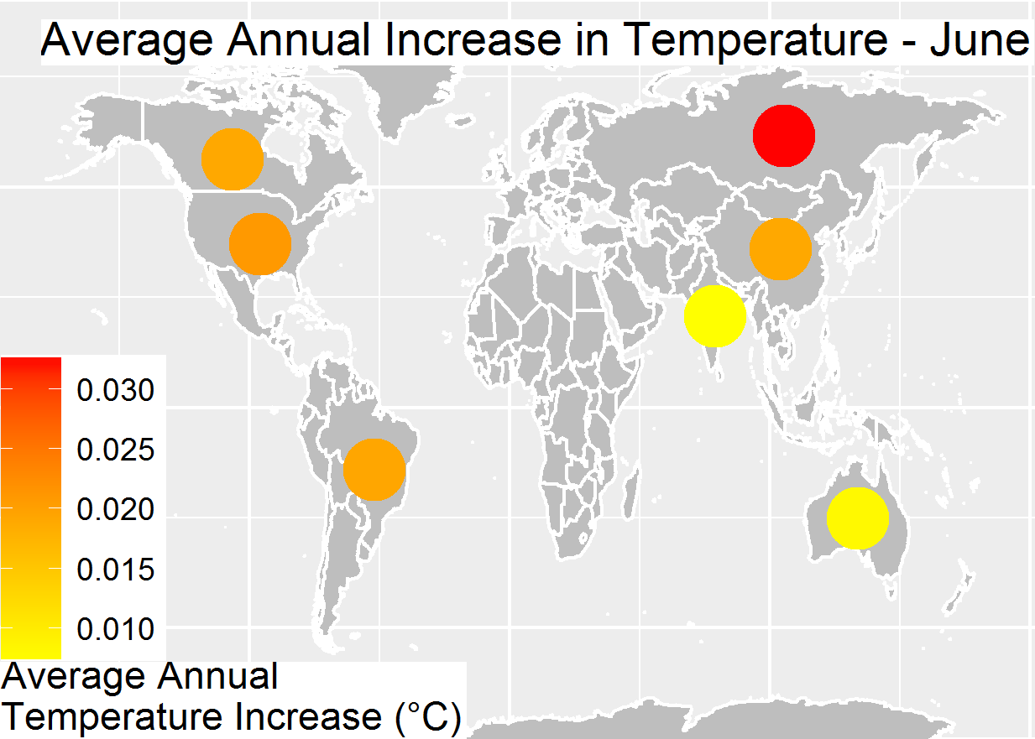
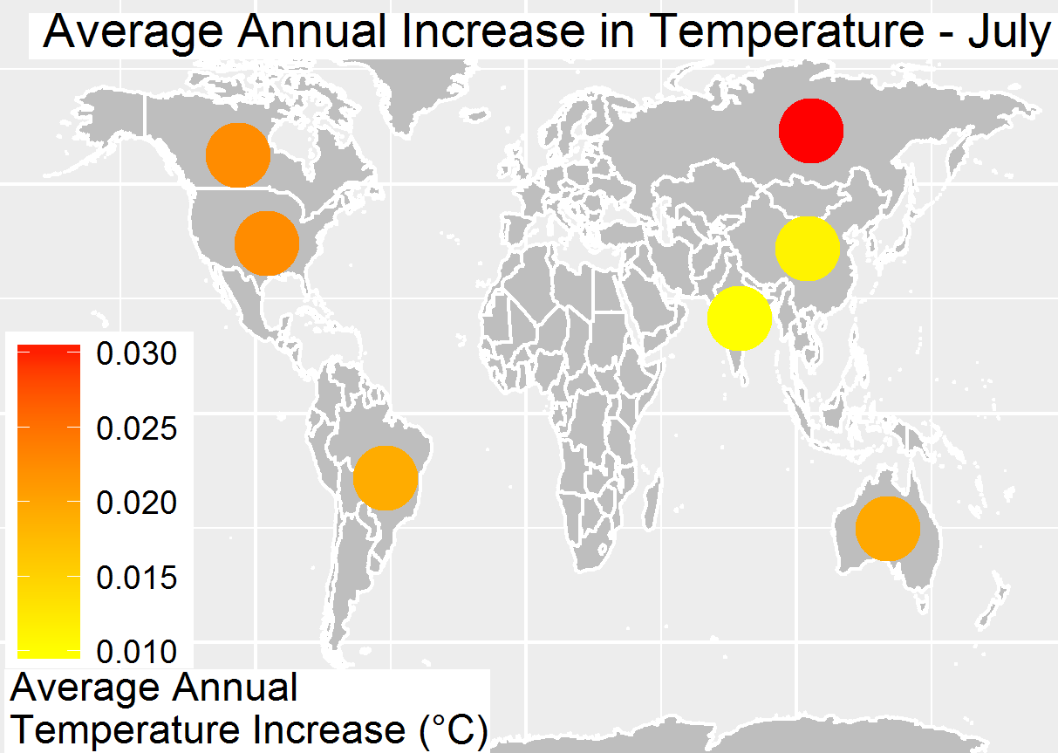
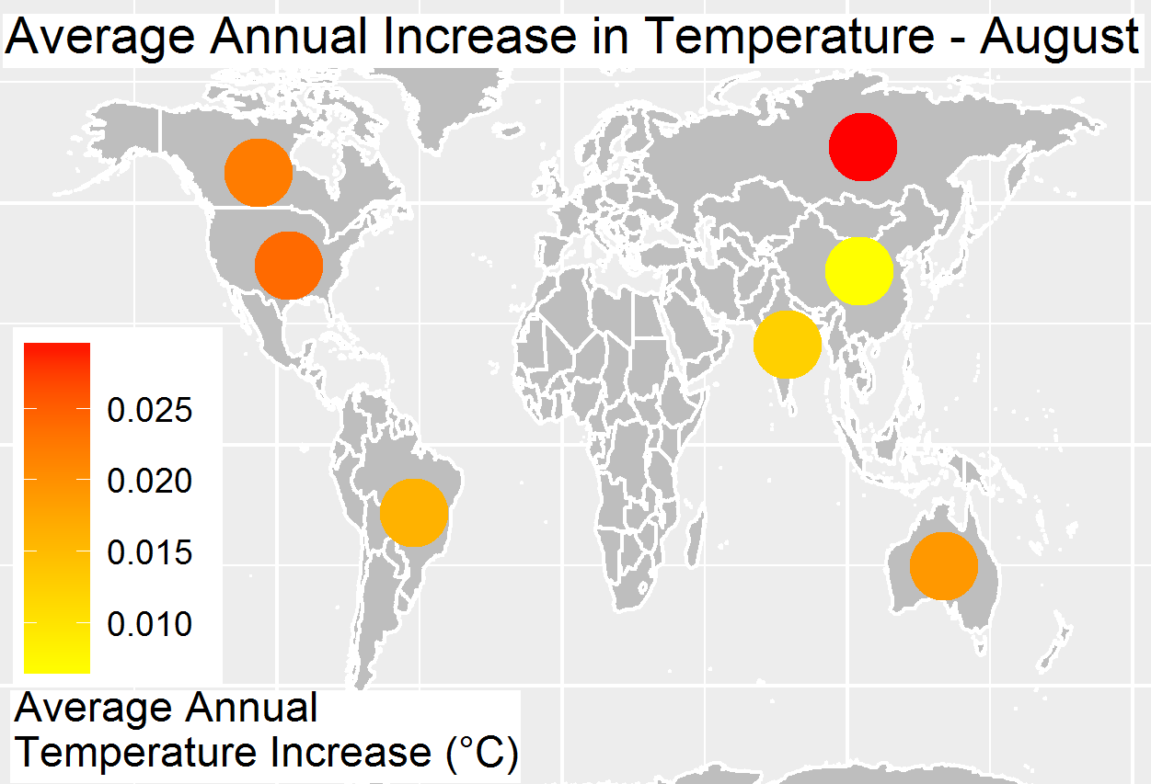
Monthly Avg Temp Increase for May,June,July,Aug from 1960

Slide 9
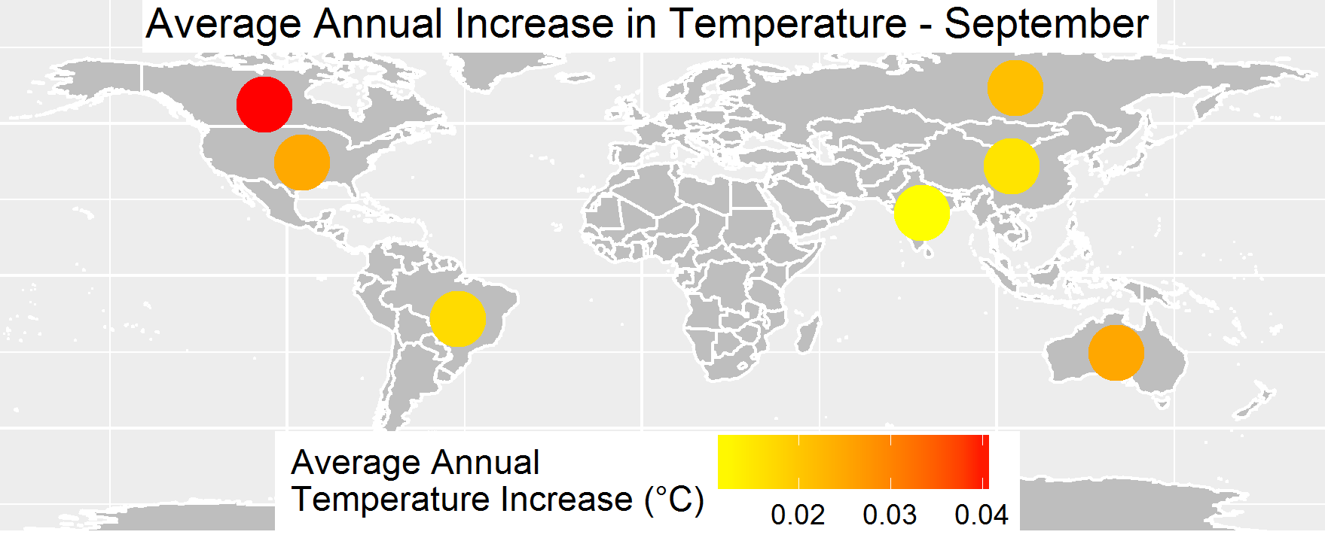
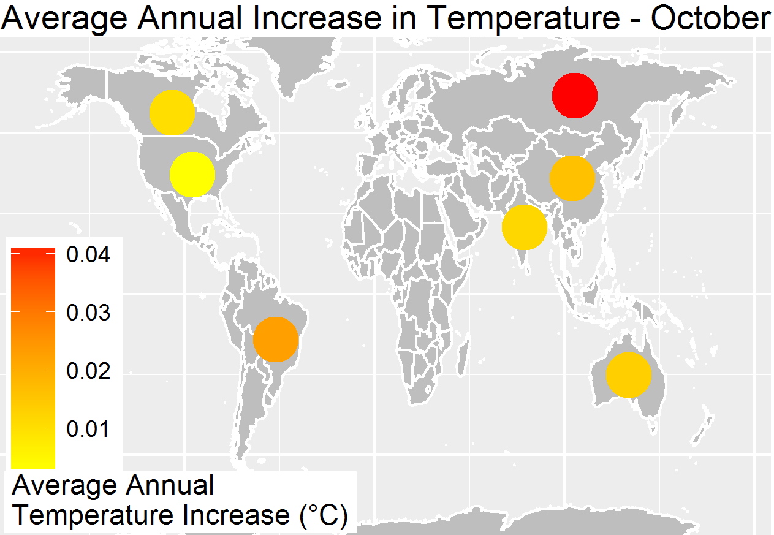
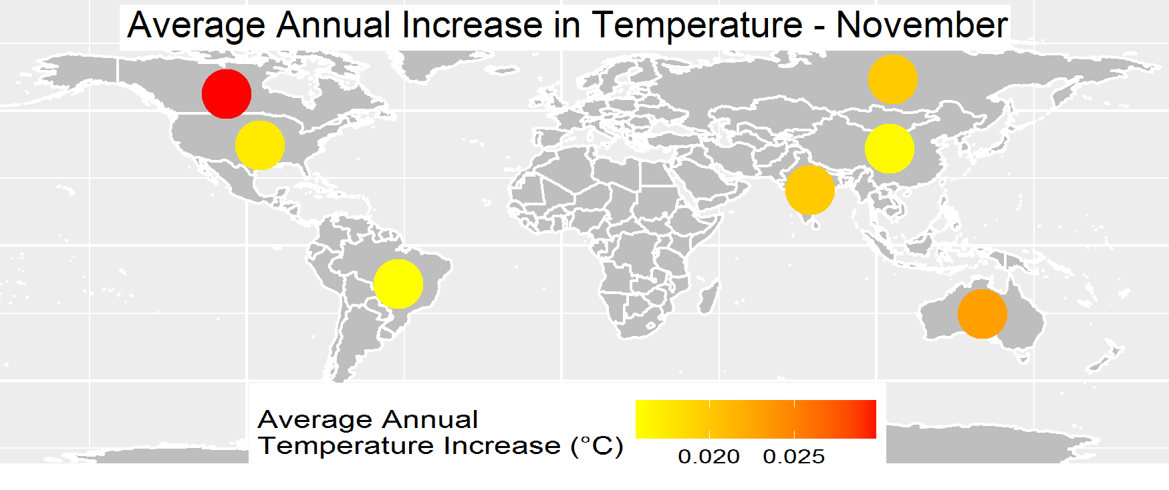
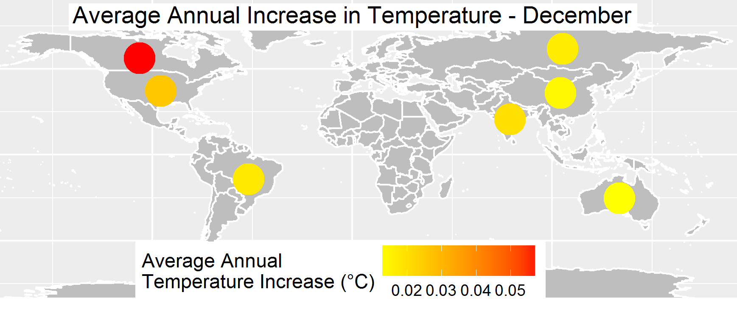
Monthly Avg Temp Increase for Sep,Oct,Nov,Dec from 1960

Slide 10
US States Year over year Change Avg Temp 1960 -2013

Slide 11
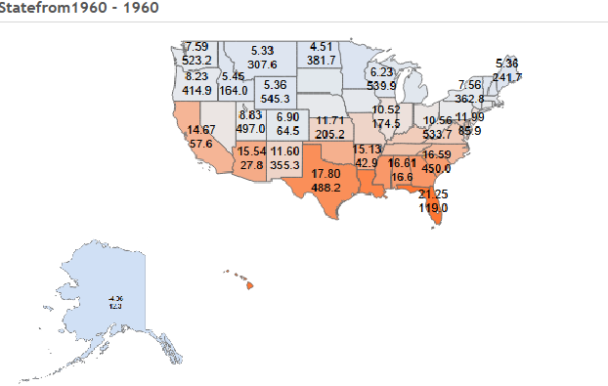
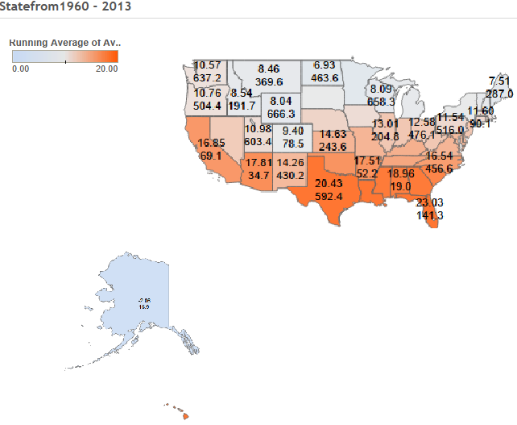
US 50 States Cumulative Total Avg Temp
In 1960 Total 545 Celsius & In 2013 Total 666 Celsius

Slide 12
Save the Earth temperature for Future Generation.
Thank you.
Global Temperature Dataset
- Data Visualization CSC 465 Spring 2016
By Joo Park , (Prab) Prabhakaran Raghavan

